Slide 1

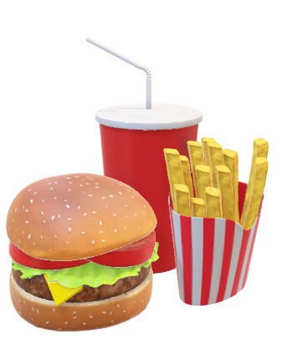
Group-05
Md. Majharul Islam(181 1678 642)
TanjEla Islam(182 2553 042)

Slide 2
What is the meaning of food review blog?
What is the goal of this blog?

Slide 3
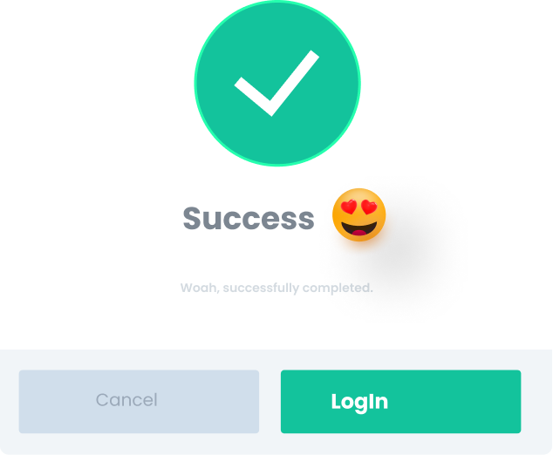
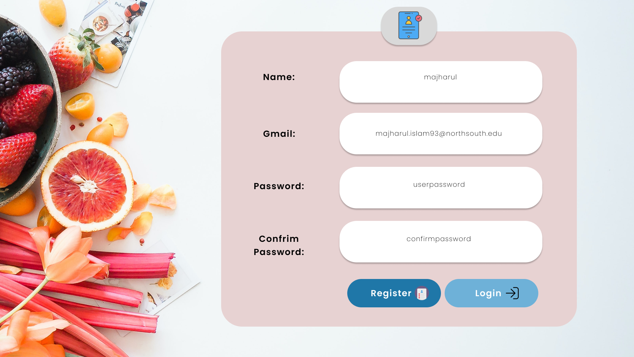
Registration

Slide 4
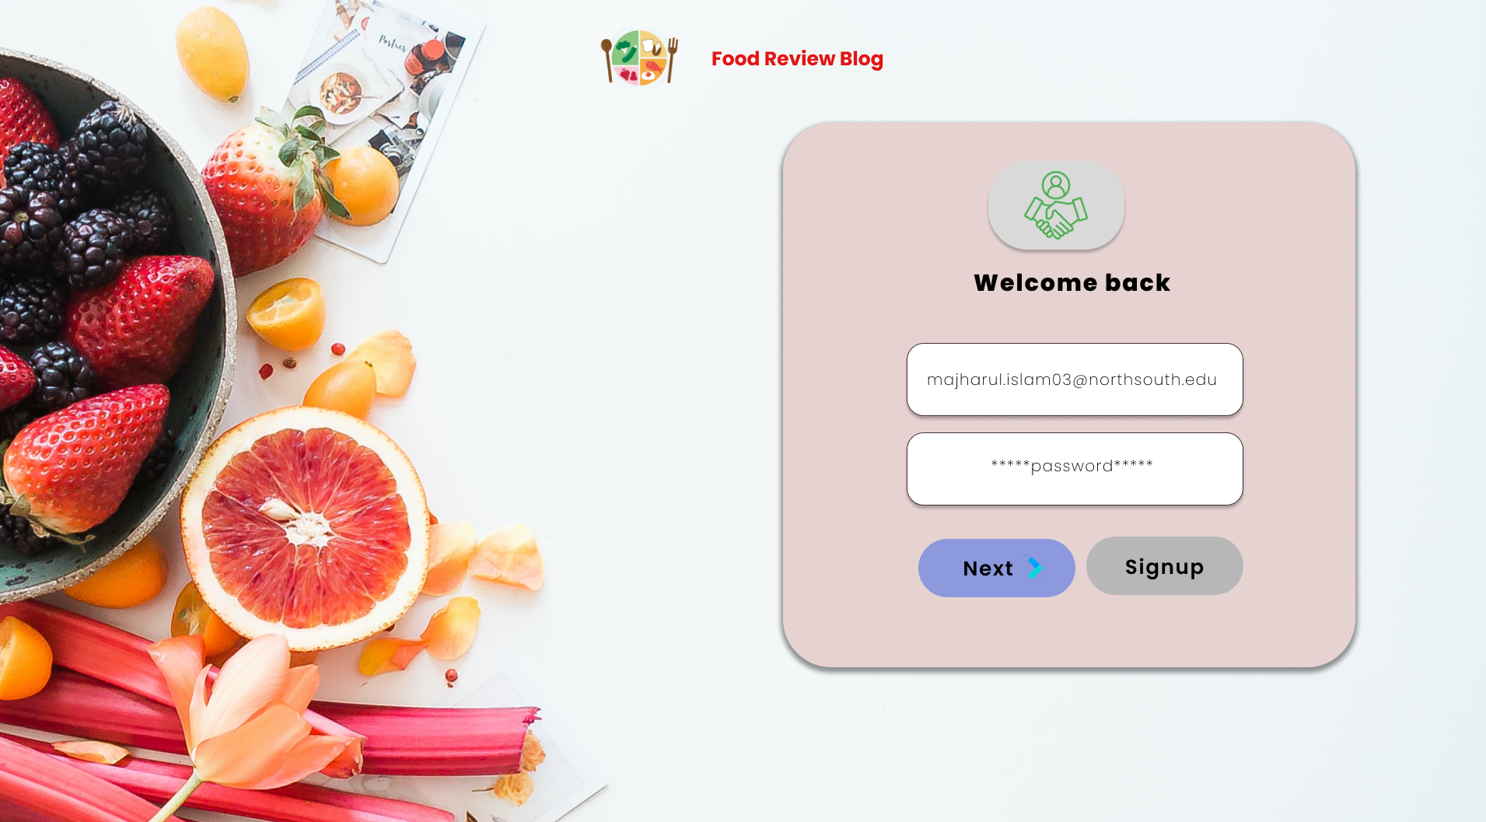
Login Part

Slide 5
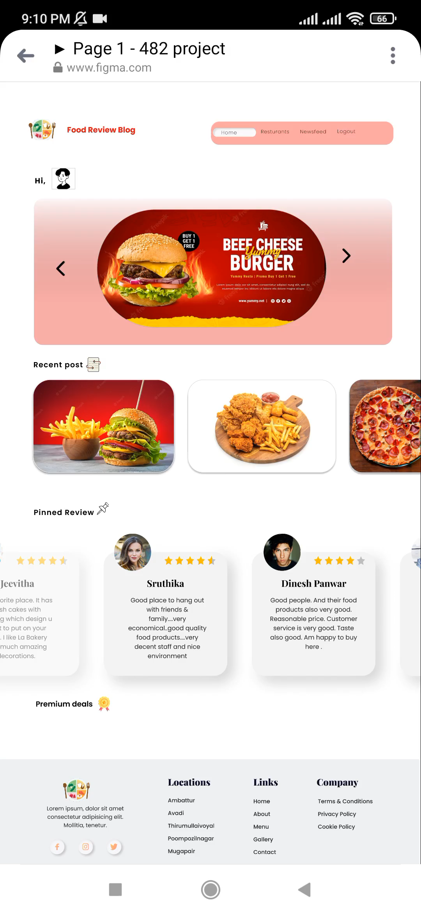



homepage
Restaurant’s Special Offer or Notice
Recent Posts
Pin Posts.

Slide 6
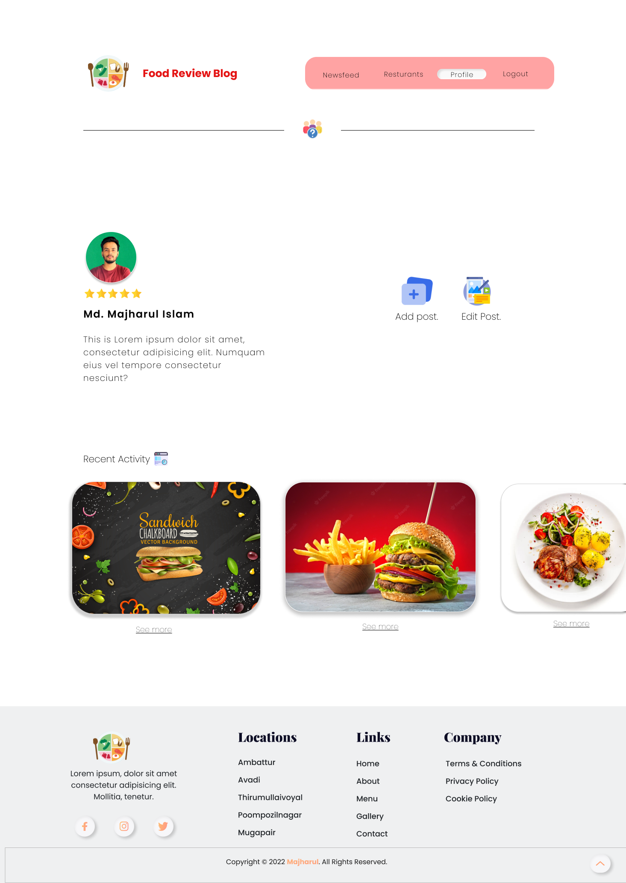


User profile
A registered User Manage, Update his/her Profile, Rating.
User Can Add and Edit previous Post.
Recent Activity – Uses Activity of a Registered User

Slide 7
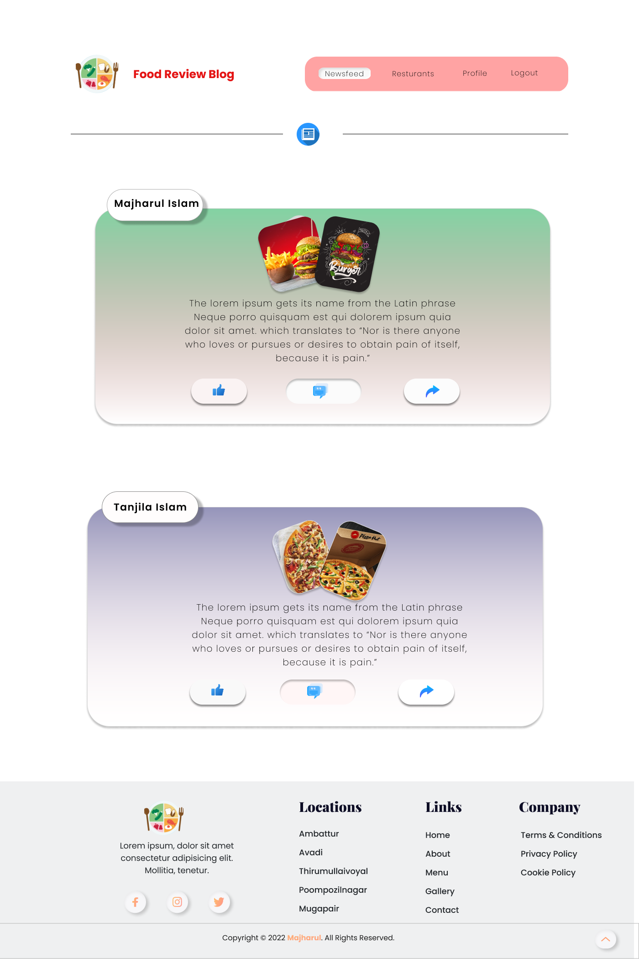
newsfeed
A registered User can see other’s Post, Reviews
Can React/Comment in other’s Post

Slide 8
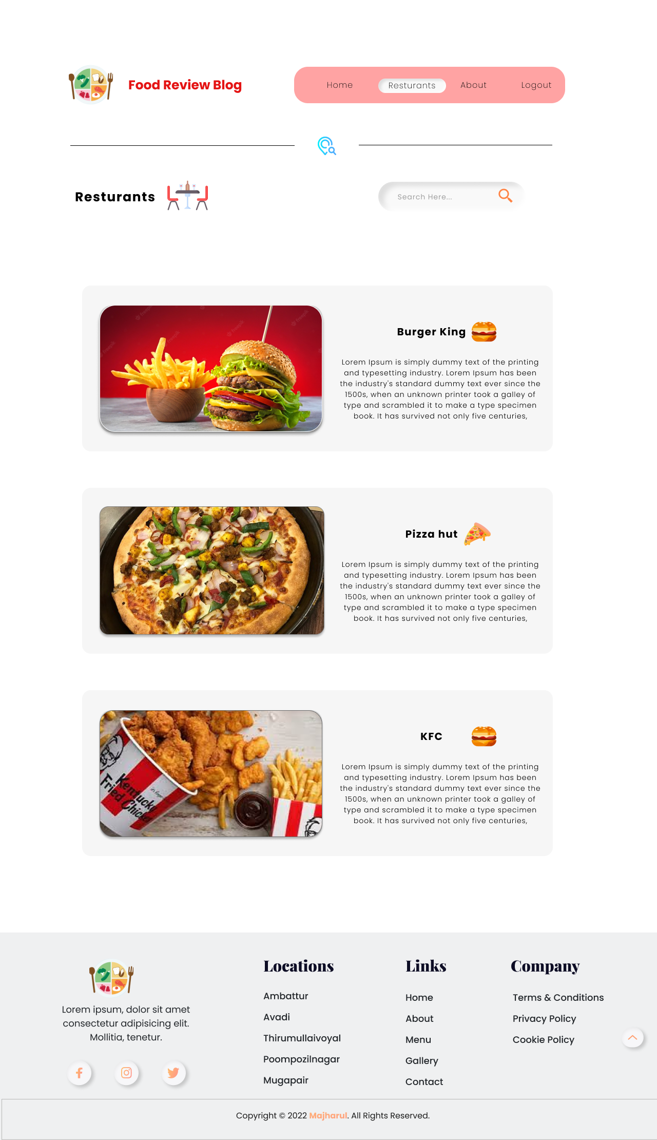
restaurants
A Restaurant Owner can share about his restaurant, Location, Rating & Special Notice by Creating A profile.
Can Search by Any Review / Reviewer

Slide 9
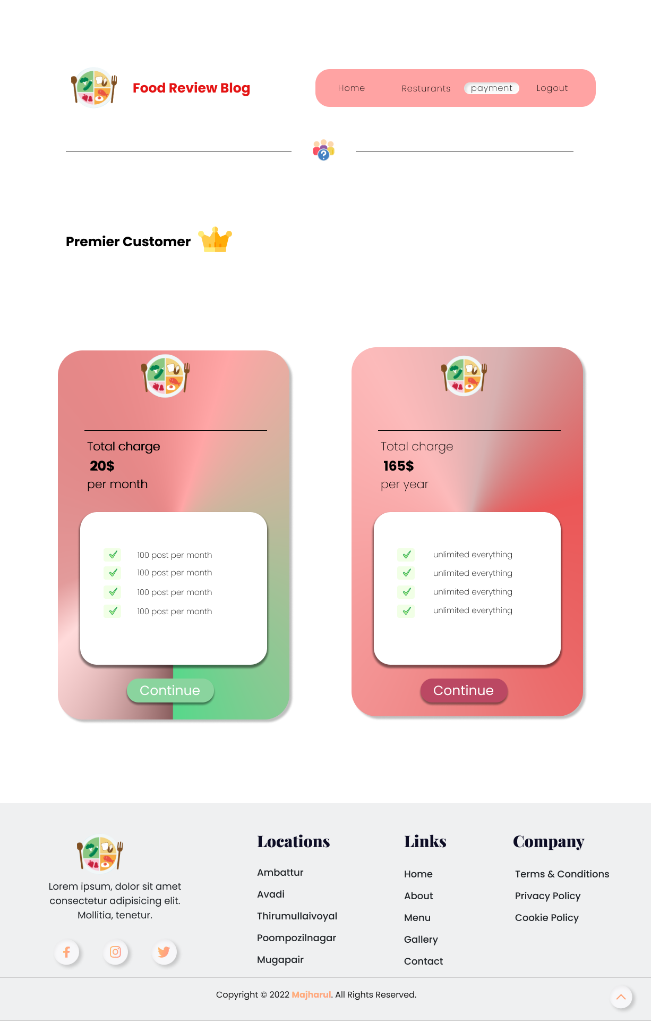
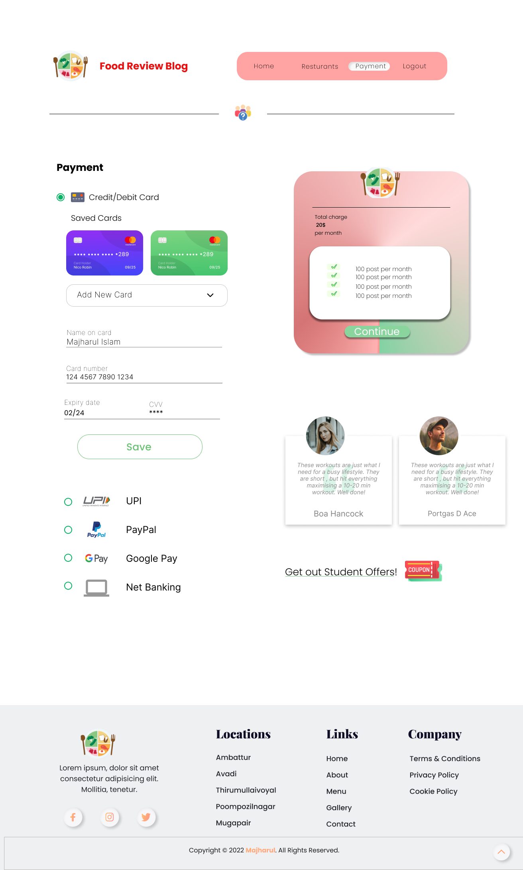
Premier customer
Act as a Special Feature
Premium Account by doing online payment.

Slide 10
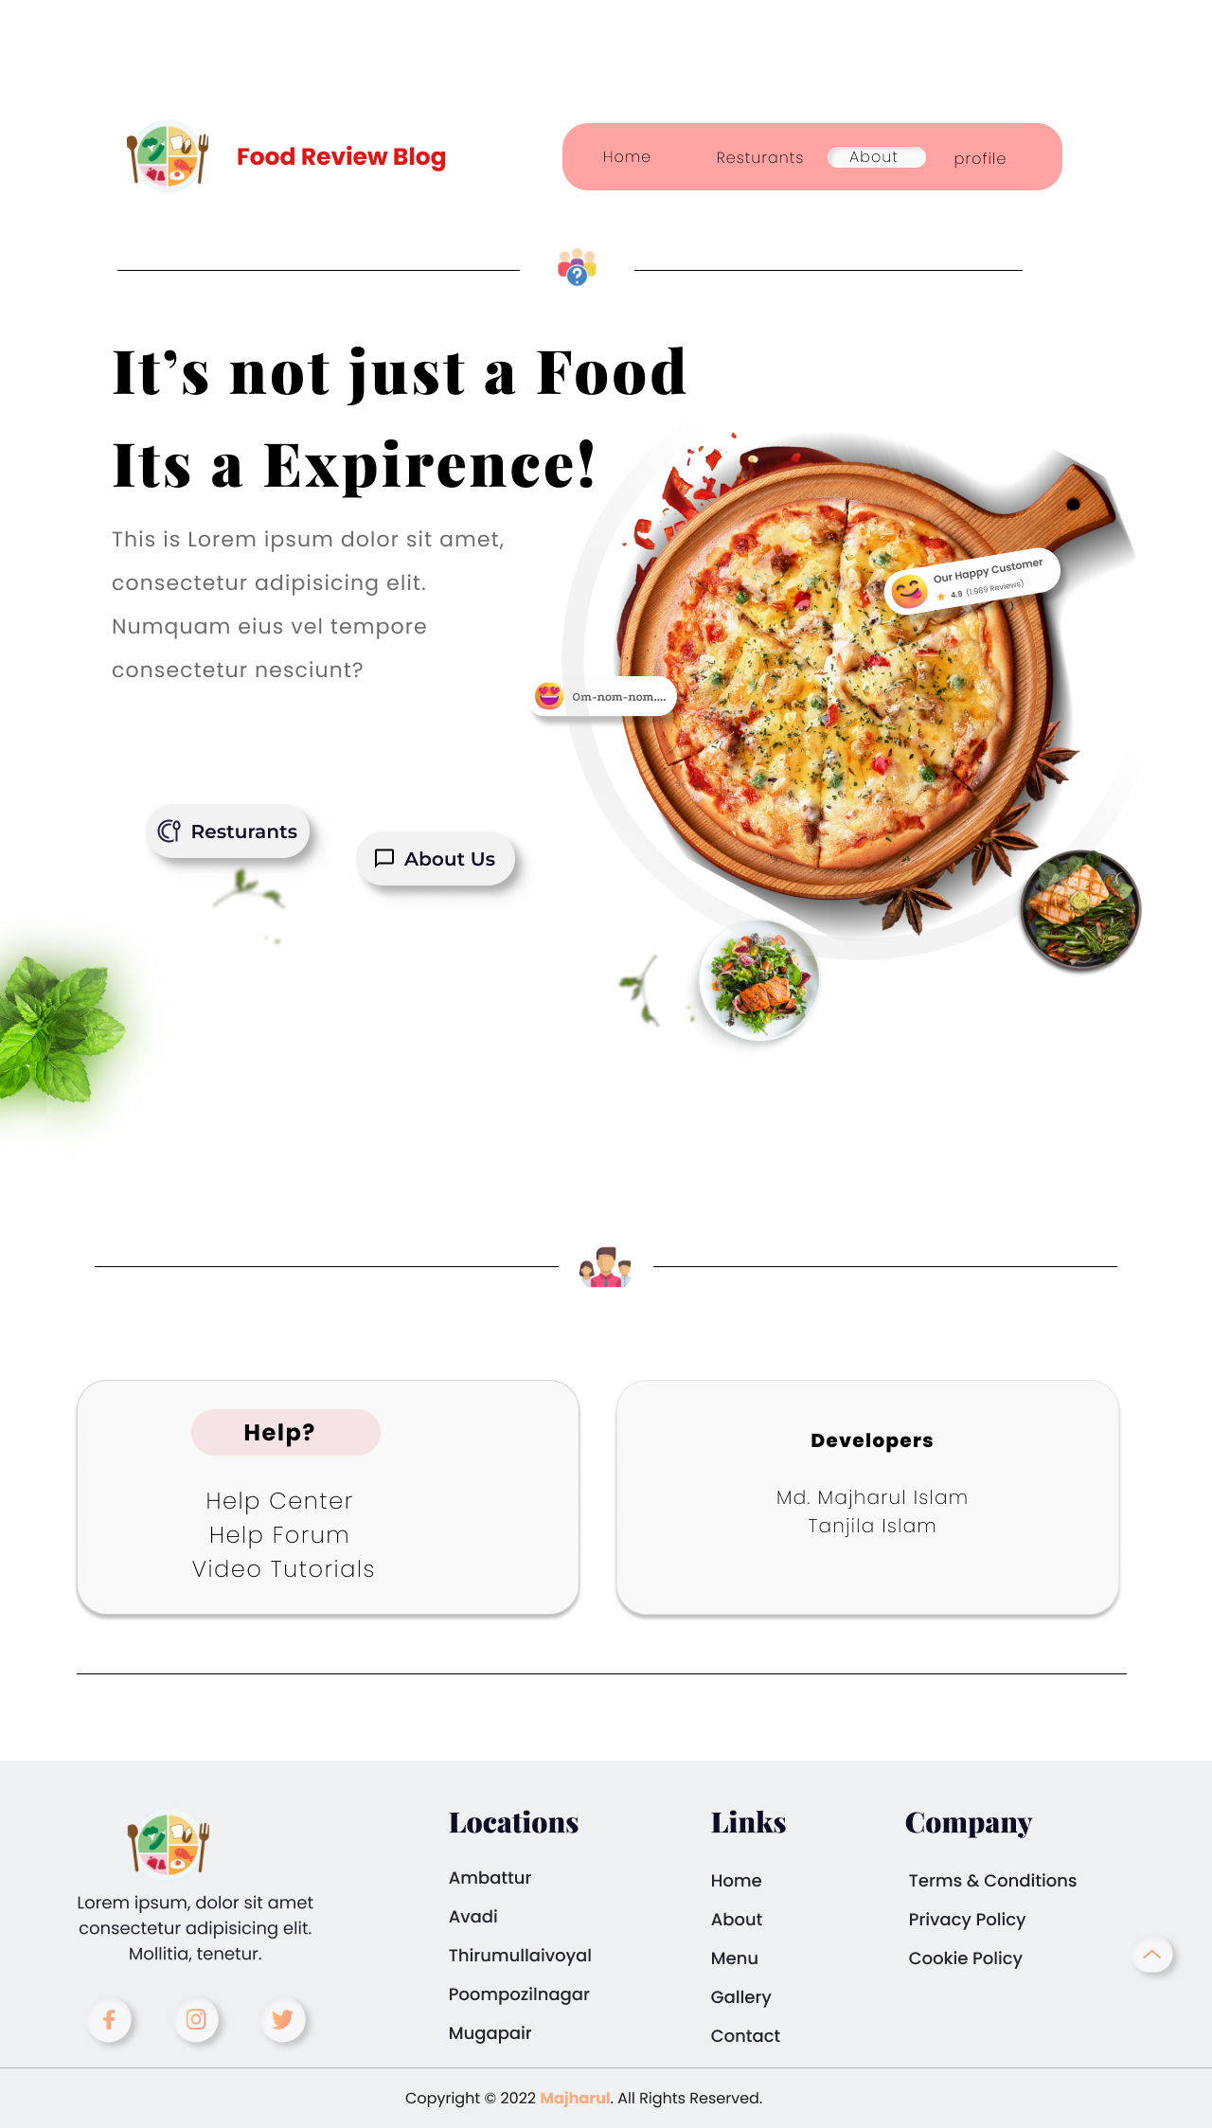
about
The Page will contain information of the Website
Find Support or any help.

Slide 11
Thank You

